Slide 1

2023-2024 State Assessment Report
Part I: NJGPA-Class of 2025

Slide 2


New Jersey Graduation Proficiency Assessment

Slide 3
First administered to 11th grade students - March 2022 (Field Test)
Algebra I, Geometry and 10th Grade ELA standards
One pathway for meeting graduation assessment requirements for Class of 2025
Scoring and Proficiency: Scaled score target ranges:
  ‘Graduation Ready’
  ‘Not Yet Graduation Ready’
New Jersey Graduation Proficiency Assessment

Slide 4
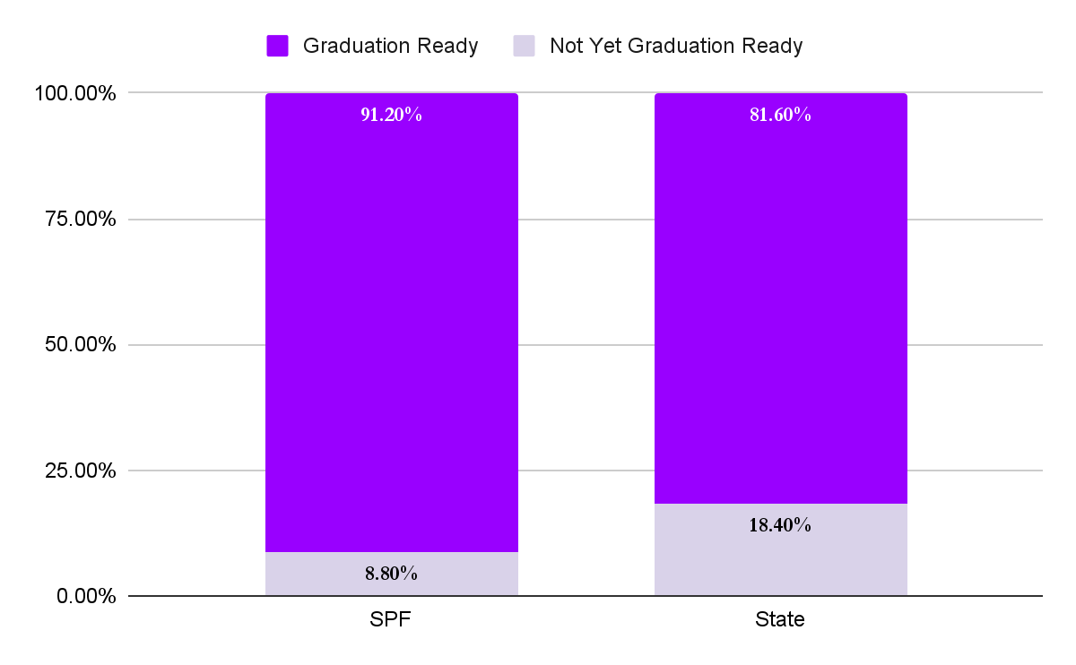
NJGPA: English Language Arts

Slide 5
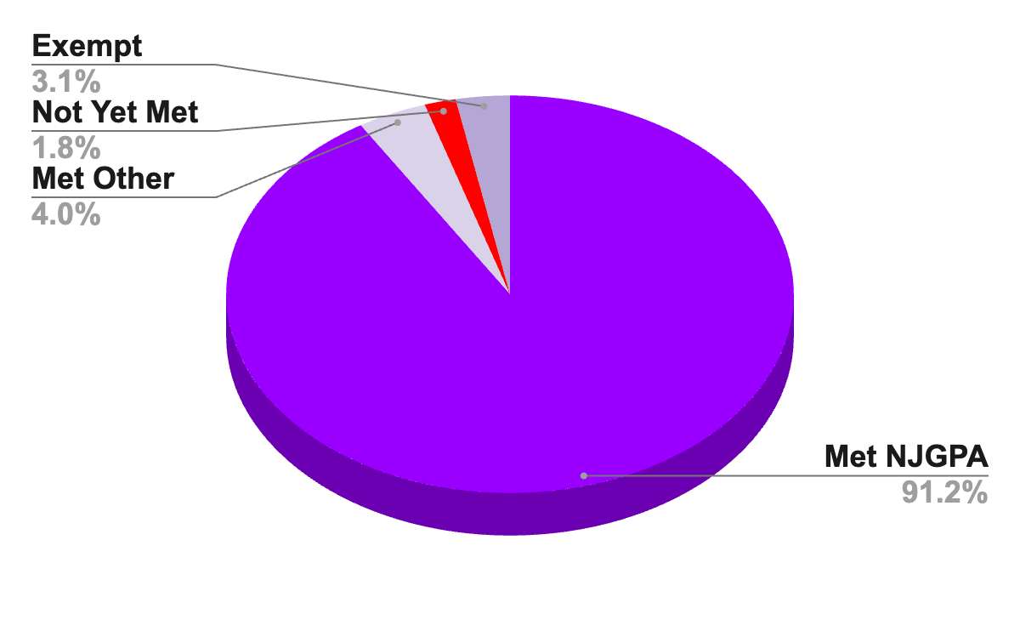
Current Status of Class of 2025: ELA Assessment Results

Slide 6
Percentage of Students Graduation Ready by Demographics
Reporting Group | Total Tested | Percentage Graduation Ready | +/- Change from 2023
Hispanic or Latino | 57 | 85.1% | -1.3
Asian | 29 | 90.6% | -9.4
Black or African-American | 36 | 82.4% | +7.4
White | 221 | 94.8% | -0.6
Two or more races | 19 | 100% | +15
Female | 191 | 94.6% | -0.4
Male | 164 | 89.1% | +1.1
Students with Disabilities | 60 | 71.7% | +11.1
Economically Disadvantaged | 25 | 88% | +13
504 | 32 | 96.9% | -0.9
English Learners | * | * | *

Slide 7
The ELA Data Suggests:
Graduation Readiness:
92% of rising seniors "graduation ready"
98% total met requirements (including exemptions)
Only 2% "not yet graduation ready"
Academic Performance:
Exceeded state averages in all major assessed areas
Improved in reading informational text, a historical challenge
Addressing Performance Gaps on NJGPA:
Narrower gaps between SPF and State in:
  Analyzing literature (character development, themes) - New Standards with recent updates are more detailed and provide direction
Continue to focus on subgroups:
  Gender differences
  Hispanic/Latino and Black/African American students

Slide 8
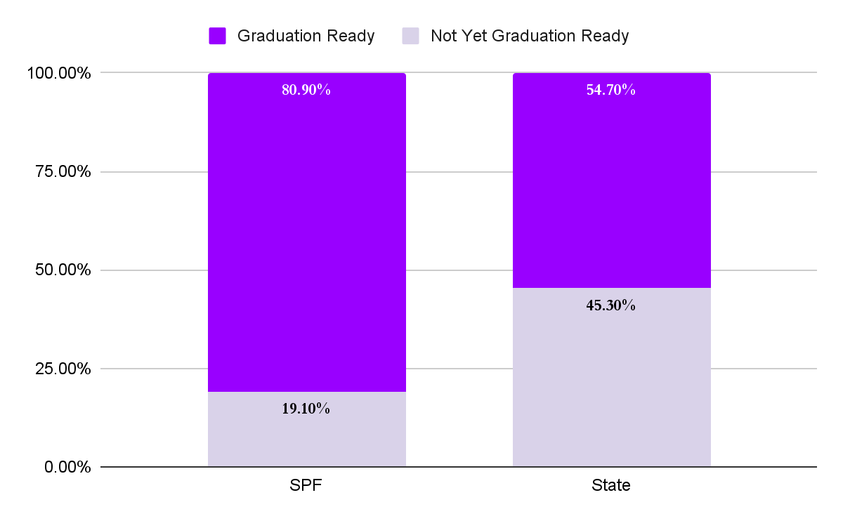
NJGPA: Mathematics

Slide 9
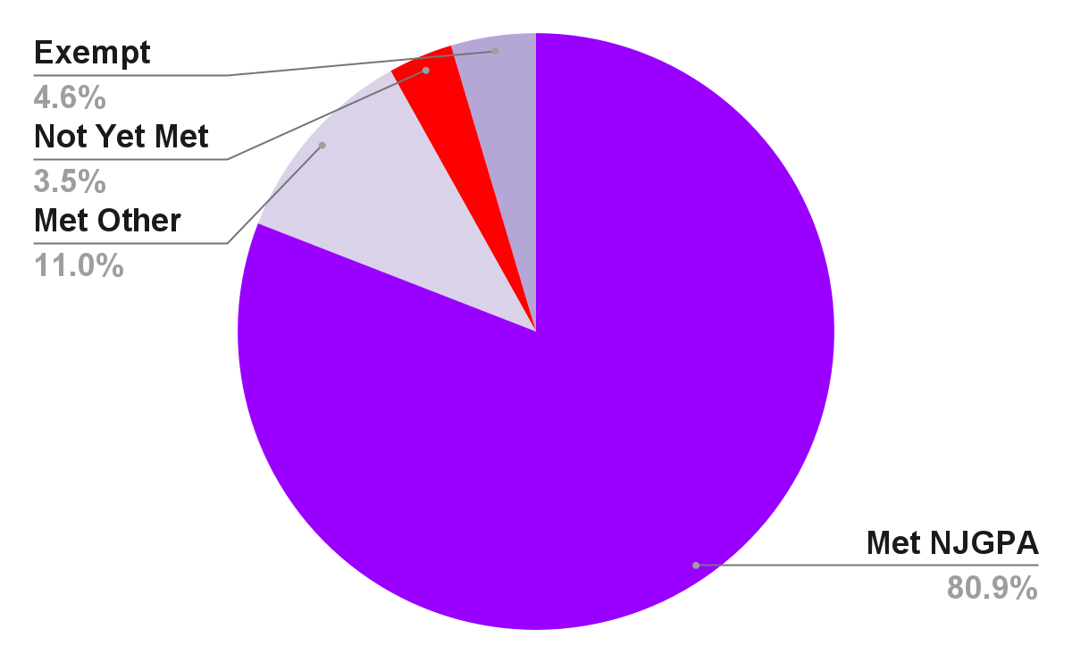
Current Status of Class of 2025: Math Assessment Results

Slide 10

Percentage of Students Graduation Ready by Demographics
Reporting Group | Total Tested | Percentage Graduation Ready | +/- Change from 2023
Hispanic or Latino | 67 | 71.6% | -5.7
Asian | 32 | 90.6% | +4.4
Black or African-American | 35 | 51.4% | +19
White | 233 | 86.3% | +1.4
Two or more races | 19 | 94.7% | +19.7
Female | 203 | 79.8% | -1.7
Male | 184 | 82.1% | +7.1
Students with Disabilities | 59 | 48.3% | +12.7
Economically Disadvantaged | 60 | 60% | +10.0
504 | 32 | 68.8% | -13.8
English Learners | * | * | *

Slide 11
The Math Data Suggests:
Graduation Readiness:
80.9% of rising seniors "graduation ready"
96.5% total met requirements (including exemptions)
Only 3.5% "not yet graduation ready"
Academic Performance:
Strengths:
  Interpreting functions, domain, and range
  Constructing linear/exponential functions
  Applying transformations on figures
  Solving similarity and right triangle problems
Areas for Improvement:
  Algebraic and Geometric reasoning to prove function properties
  Multi-step contextual problems with quadratic equations
Addressing Performance Gaps on NJGPA:
Continue to focus on subgroups:
  Black/African American students, Students with Disabilities and Economically Disadvantaged

Slide 12
Thank you!
Part II Coming this Fall!

